Slide 1
Prediciton of salmon scale age using CNN
Endre Moen

Slide 2
Datasett from HI and Rådgivende Biologer(RB)
HI: 2014 – 2017
Remove 2014 – ‘pressete bilder’
Tiff color images
Rådgivende Biologer: 2016 – 2017
Jpg – black and white

Slide 3
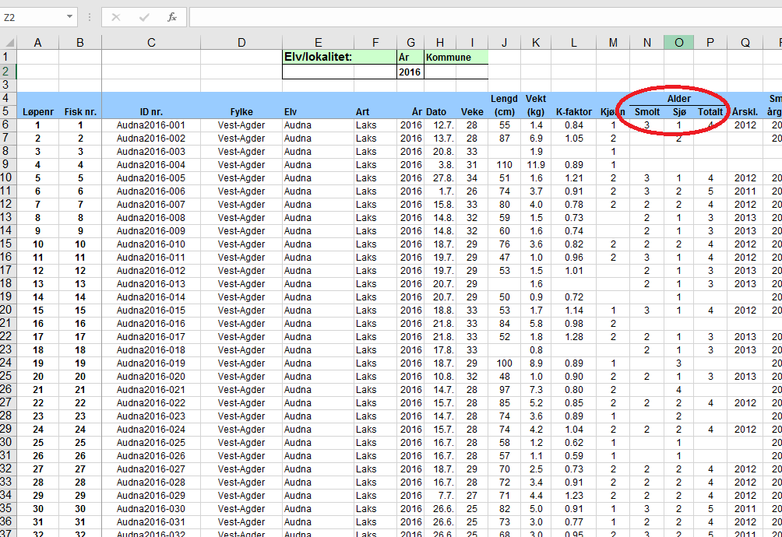
Excel sheet

Slide 4
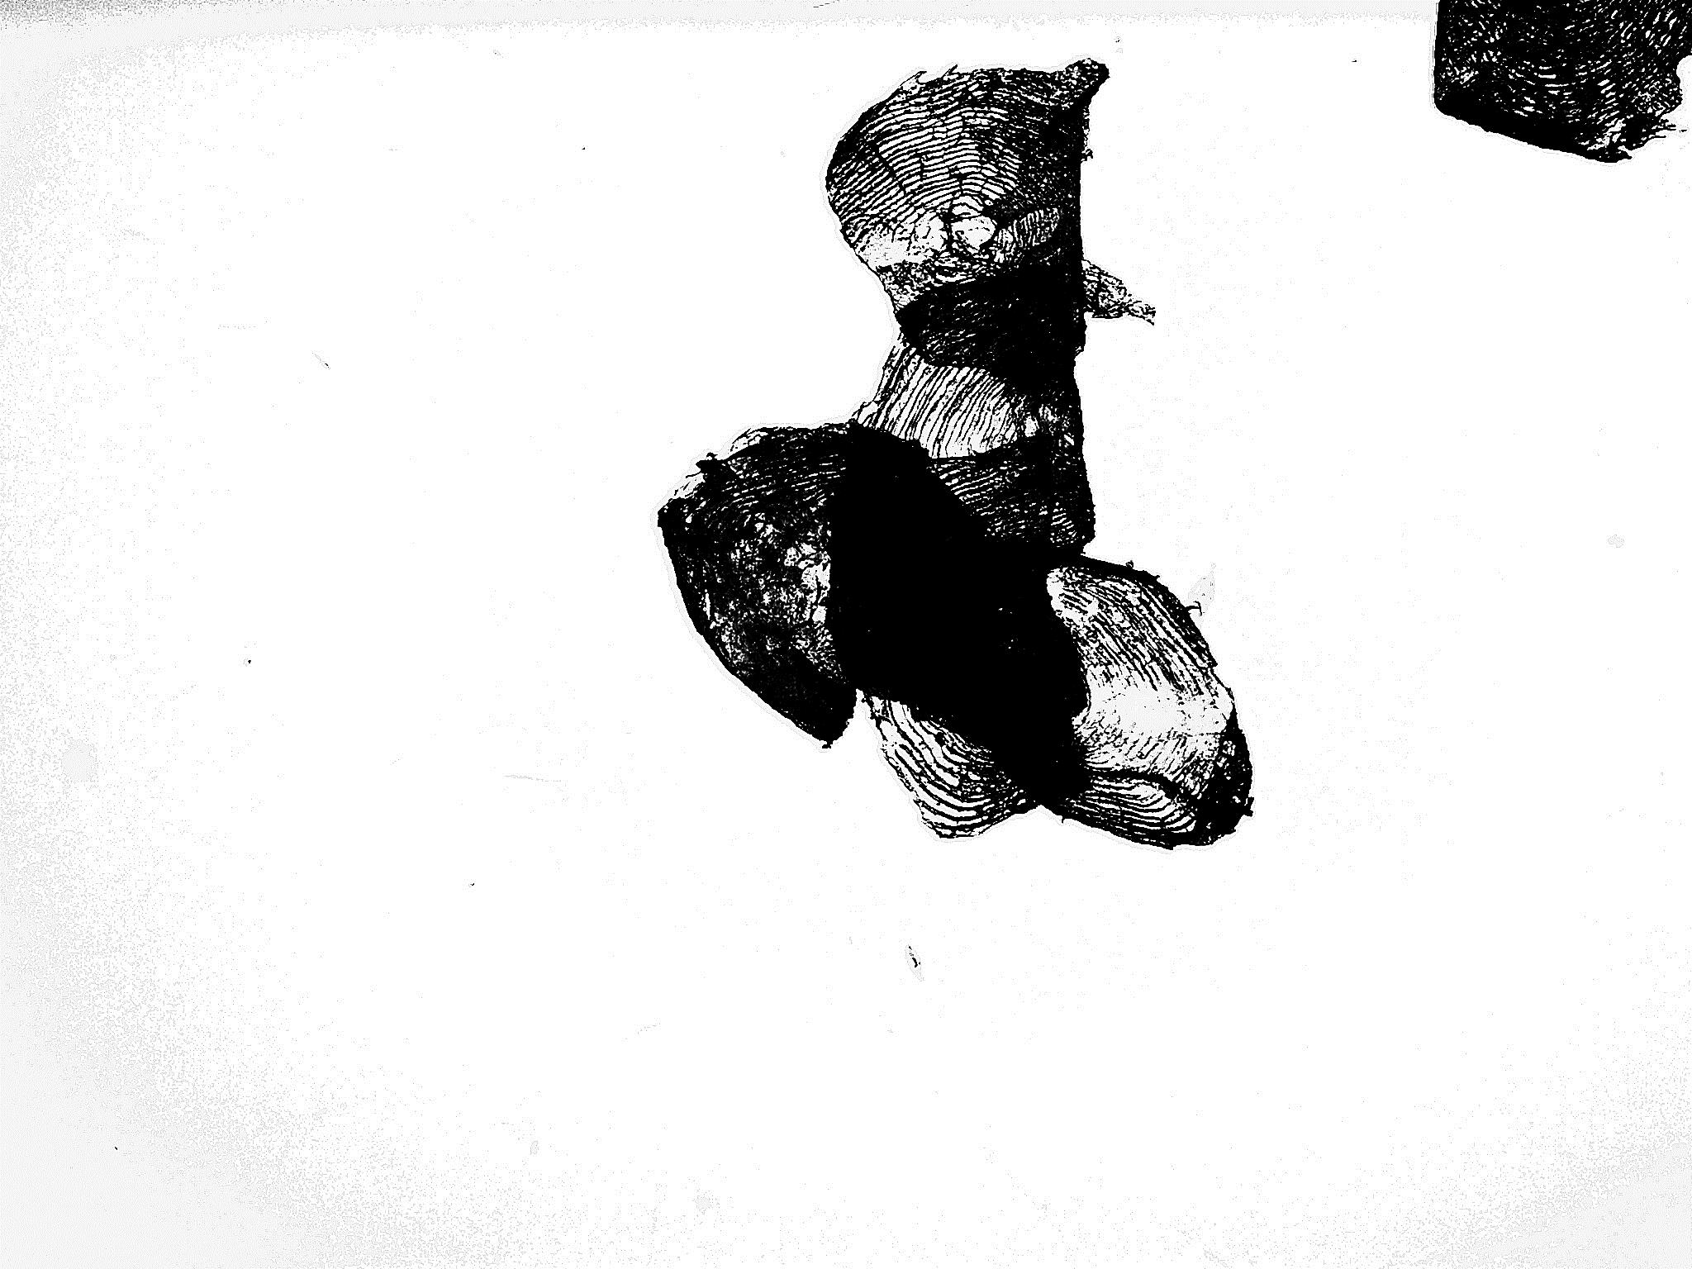
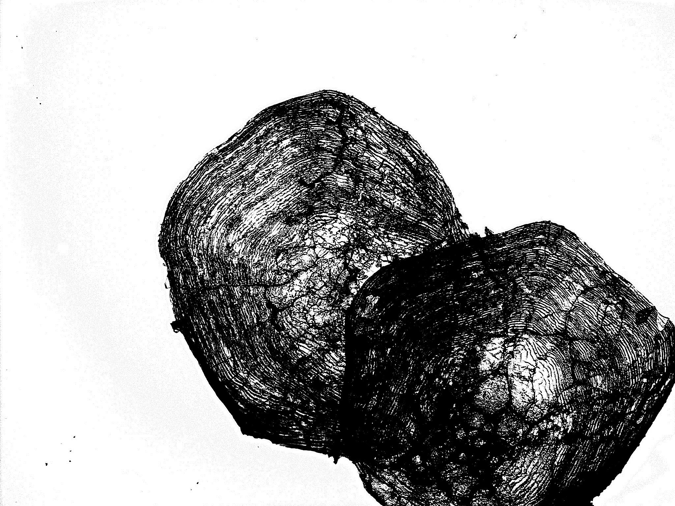

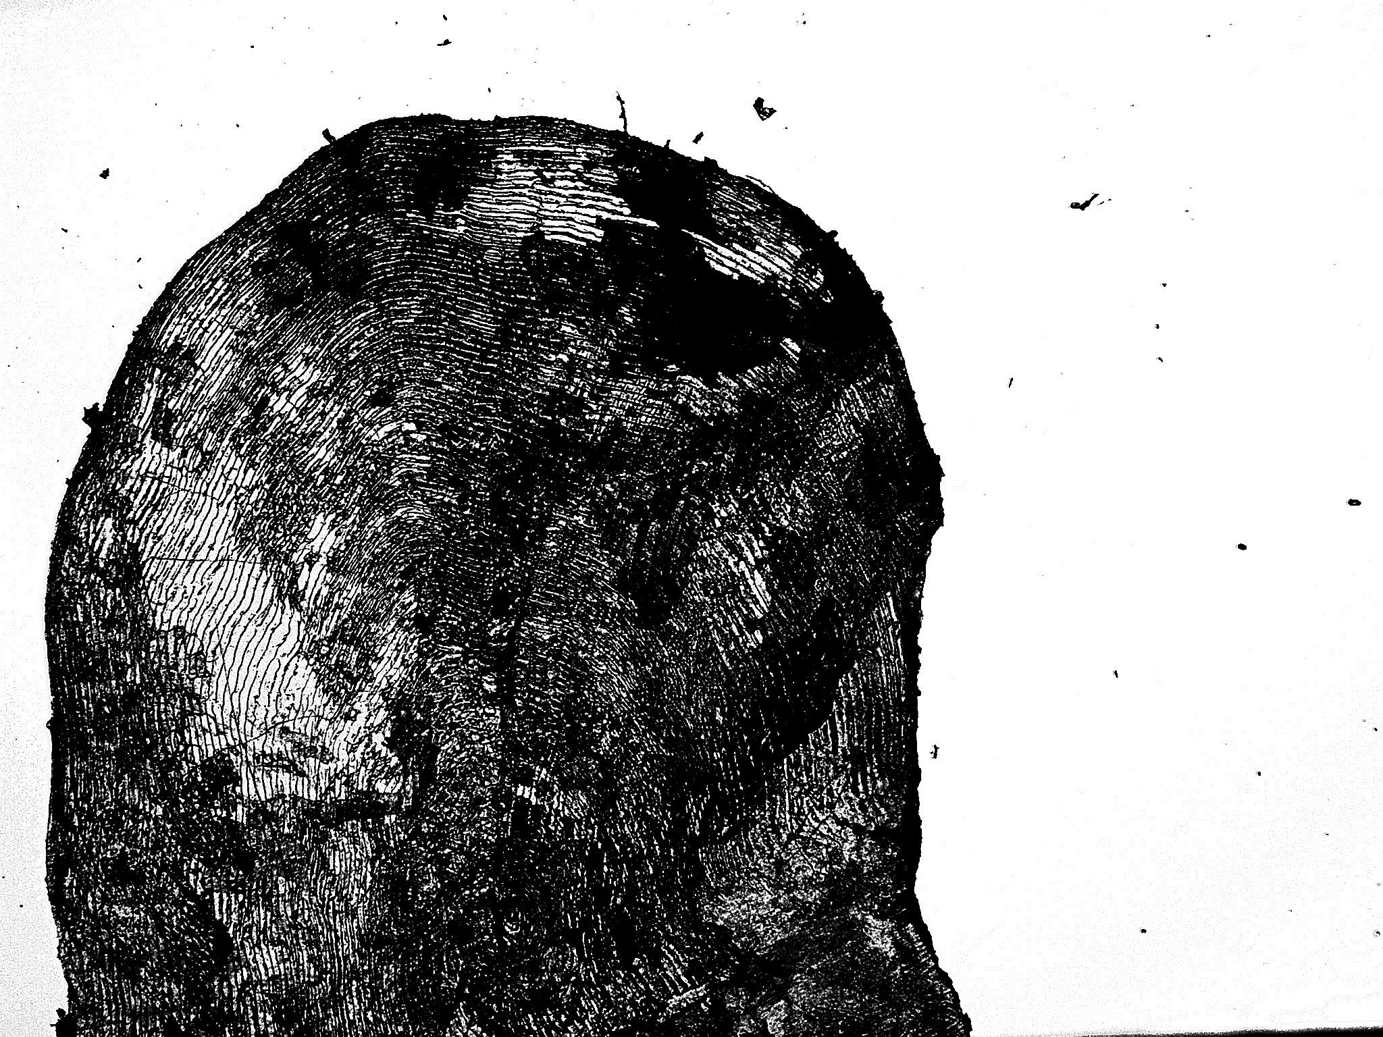
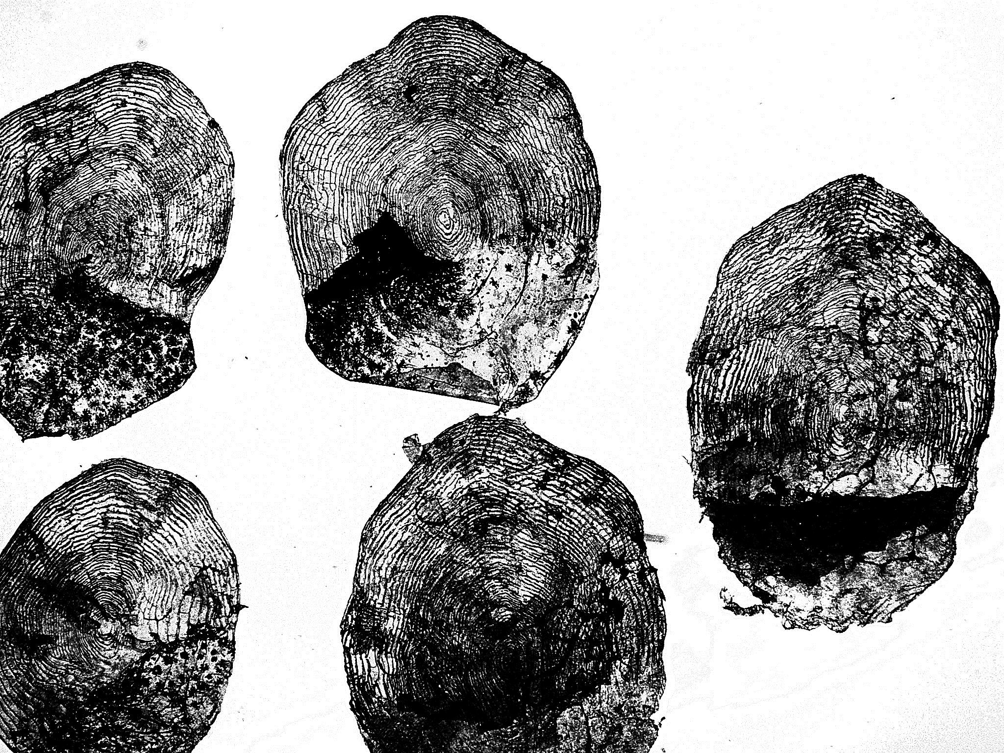
Cleaning images
Empty image with total age
Unreadable to an expert
Remove images with 2 or more scales

Slide 5
Convert and Network
Convert tif to jpg
Convert to black and white
Predict with inception V3 on 1 color-channel
input_type = Input(shape=(299, 299, 1) )
def train_validate_test_split(scales, validation_set_size = 0.15, test_set_size = 0.15, a_seed = 8):

Slide 6
Filtered images and predictions
Total datasett: 16152
HI: 3848
RB: 12304
Referenced files with total age in excel: 7505

Slide 7
Subset 1 – total age
Subset of actual files, with total age: 6858
Not all files are referenced in excel due to e.g spelling error
Prediction – total age: val_mse: 1.06
Epoch 30/150
1600/1600 [==============================] - 600s 375ms/step - loss: 1.0785 - acc: 0.4520 - mean_squared_error: 1.0785 - mean_absolute_percentage_error: 22478877.4491 - val_loss: 1.0591 - val_acc: 0.4533 - val_mean_squared_error: 1.0591 - val_mean_absolute_percentage_error: 18969899.1173

Slide 8
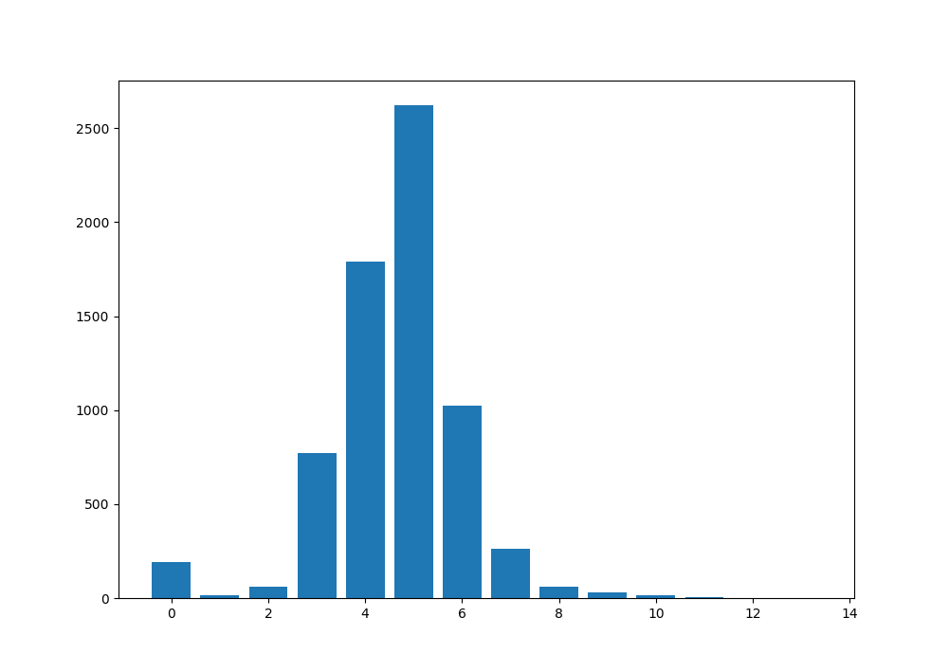
Total age distribution

Slide 9
Subset 2 – river- sea- total-age
Subset also containing river- and sea-age: 5365
Prediction – total age: val_mse: 1.1
Epoch 18/150
1600/1600 [==============================] - 607s 379ms/step - loss: 0.8695 - acc: 0.4634 - mean_squared_error: 0.8695 - mean_absolute_percentage_error: 15.8922 - val_loss: 1.1008 - val_acc: 0.4373 - val_mean_squared_error: 1.1008 - val_mean_absolute_percentage_error: 16.2651

Slide 10
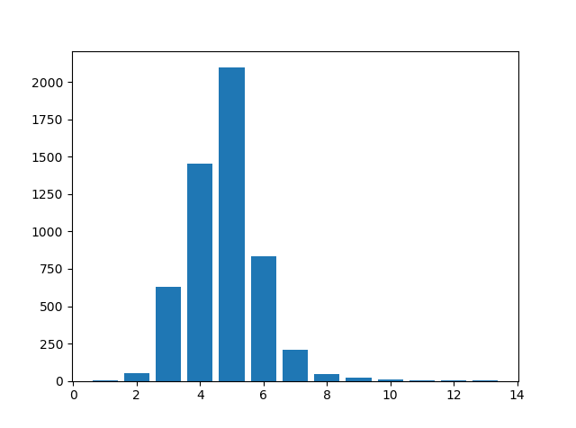
River- Sea- Total- age distribution

Slide 11
Other parameters to predict
River age (‘smolt alder’)
Sea age
Farmed/wild salmon
Spawning zones

Slide 12
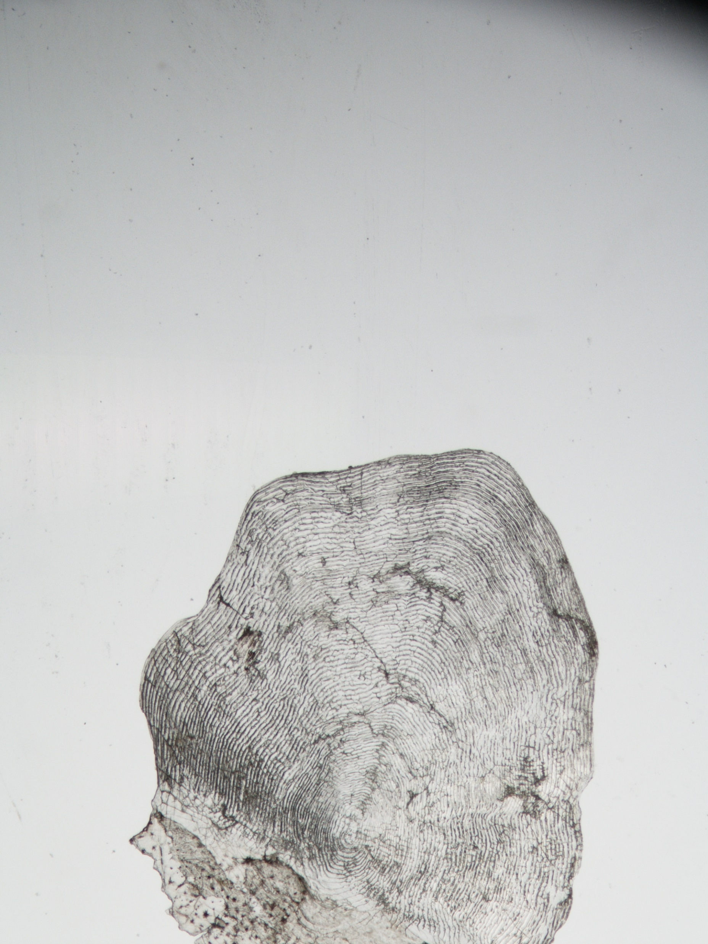
Left: farmed, right: wild, has spawned

